Slide 1
A Method of Moments Embedding Constraint and its Application to Semi-Supervised Learning*
Michael Majurski
UMBC/NIST
*rejected from CVPR as “Novel & interesting, but to early stage for publication.”

Slide 2
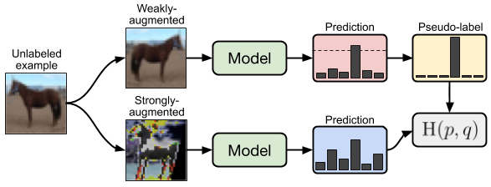
Pseudo-Labeling (PL) with Consistency Regularization
"FixMatch: Simplifying semi supervised learning with consistency and confidence"

Slide 3




Dataset: CIFAR10
CIFAR10 has 60000 train images and 10000 test
Images are 32x32 pixels
CIFAR10 is a standard baseline test for semi-supervised classification

Slide 4
Current PL Approach
Selecting "good/valid" PL relies on logit thresholding
Ideally, we want a well calibrated model of how likely a sample belongs to each class
Logits are not well calibrated probabilities
Softmax of logits is just a nearest neighbor assignment in the embedding space
Softmax tends to produce cones classes radially away from the zero point (in high D embedding space)

Slide 5
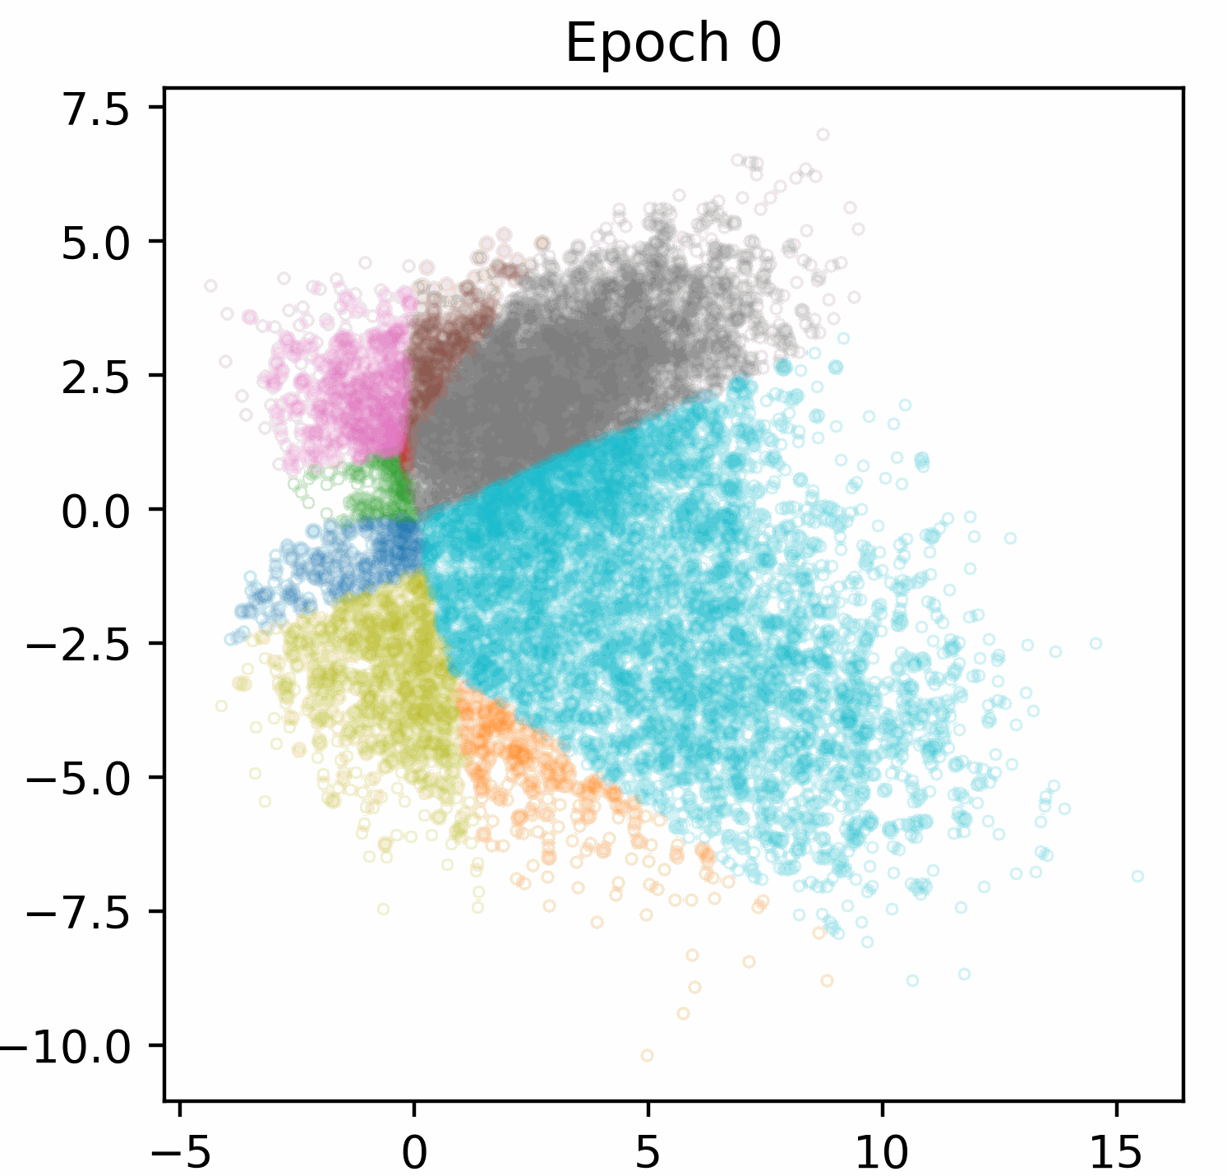
Softmax Embedding Space
Dataset: CIFAR-10 Model: WRN-28-2

Slide 6
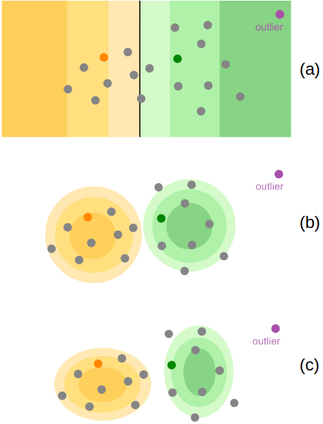
The Outlier Problem
NN Classifiers rely on a softmax final activation layers.
Softmax predicts the conditional probability p(Y|X).
Replacing softmax with a generative method that models the joint probability p(Y, X) can improve capability.
Models using a final layer capable of learning the joint probability p(Y, X) can infer the conditional p(Y|X).
Softmax perceptrons, by definition, over-confidently hallucinate when given unexpected inputs.

Slide 7
The Outlier Problem
Given input X , model predicts a soft pseudo-distribution of labels Y.
argmax converts into a hard label.
If X is far from the decision boundary softmax predicts Y with high confidence.
Works well for inlier samples
Those well represented by the training distribution
Outlier X is is likely far from the decision boundary, incorrectly assigning high confidence.
Outlier X can be flagged as a low-probability outlier, rather than confidently predicting a label.

Slide 8
The Outlier Problem
Exploring how generative modeling of the joint probability can improve the situation.
Prediction with:
fully-supervised softmax
semi-supervised Kmeans
semi-supervised AAGMM.

Slide 9
Contributions
A novel Method of Moments (MoM) based embedding constraint
Enables the model to learn the decision boundary and the latent joint distribution.
This constraint ensures that each latent cluster exhibits a well-behaved Gaussian shape.
A replacement of the final linear+softmax activation layer of the neural network with:
axis-aligned differentiable Gaussian Mixture Model (AAGMM)
or an equal variance version named KMeans
Both trained via back propagation with explicit modeling of class cluster centroids.

Slide 10
Embedding Constraints via Moments
Gaussian Moments
First Order (position)
Cluster mean should overlap the learned cluster center
Second Order (variance)
All above plus:
Cluster covariance should be identity matrix
Third Order (skew)
All above plus:
Skew matrix should be identity matrix
Fourth Order (kurtosis)
All above plus:
Kurtosis matrix should be identity matrix
Places restrictions on the embedding space learned by the model. Goal is to make added a generative model on the embedding easier.
If the embedding space is well behaved, and distance from centroid relates to distance from the learned class concept, filtering PL is more accurate.

Slide 11
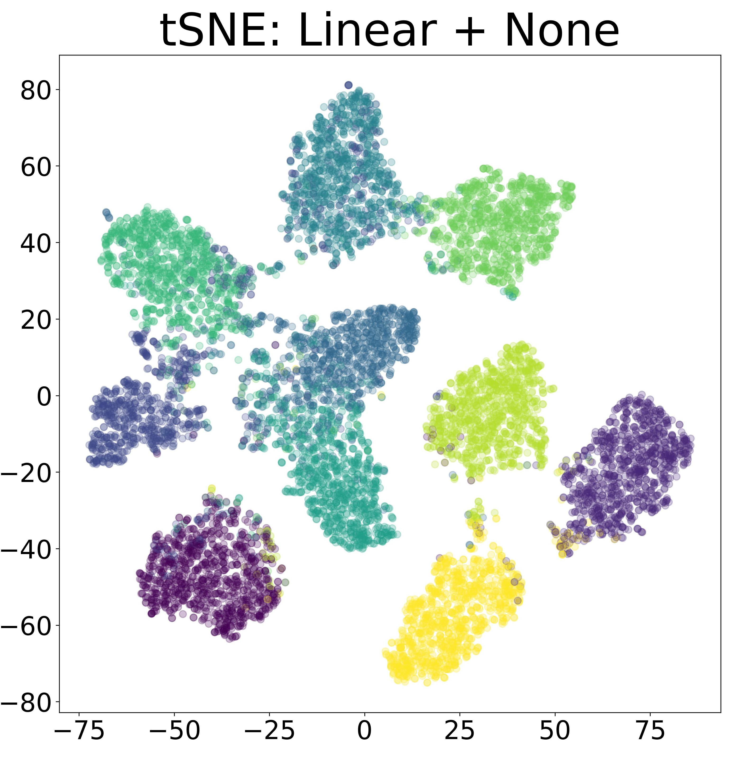
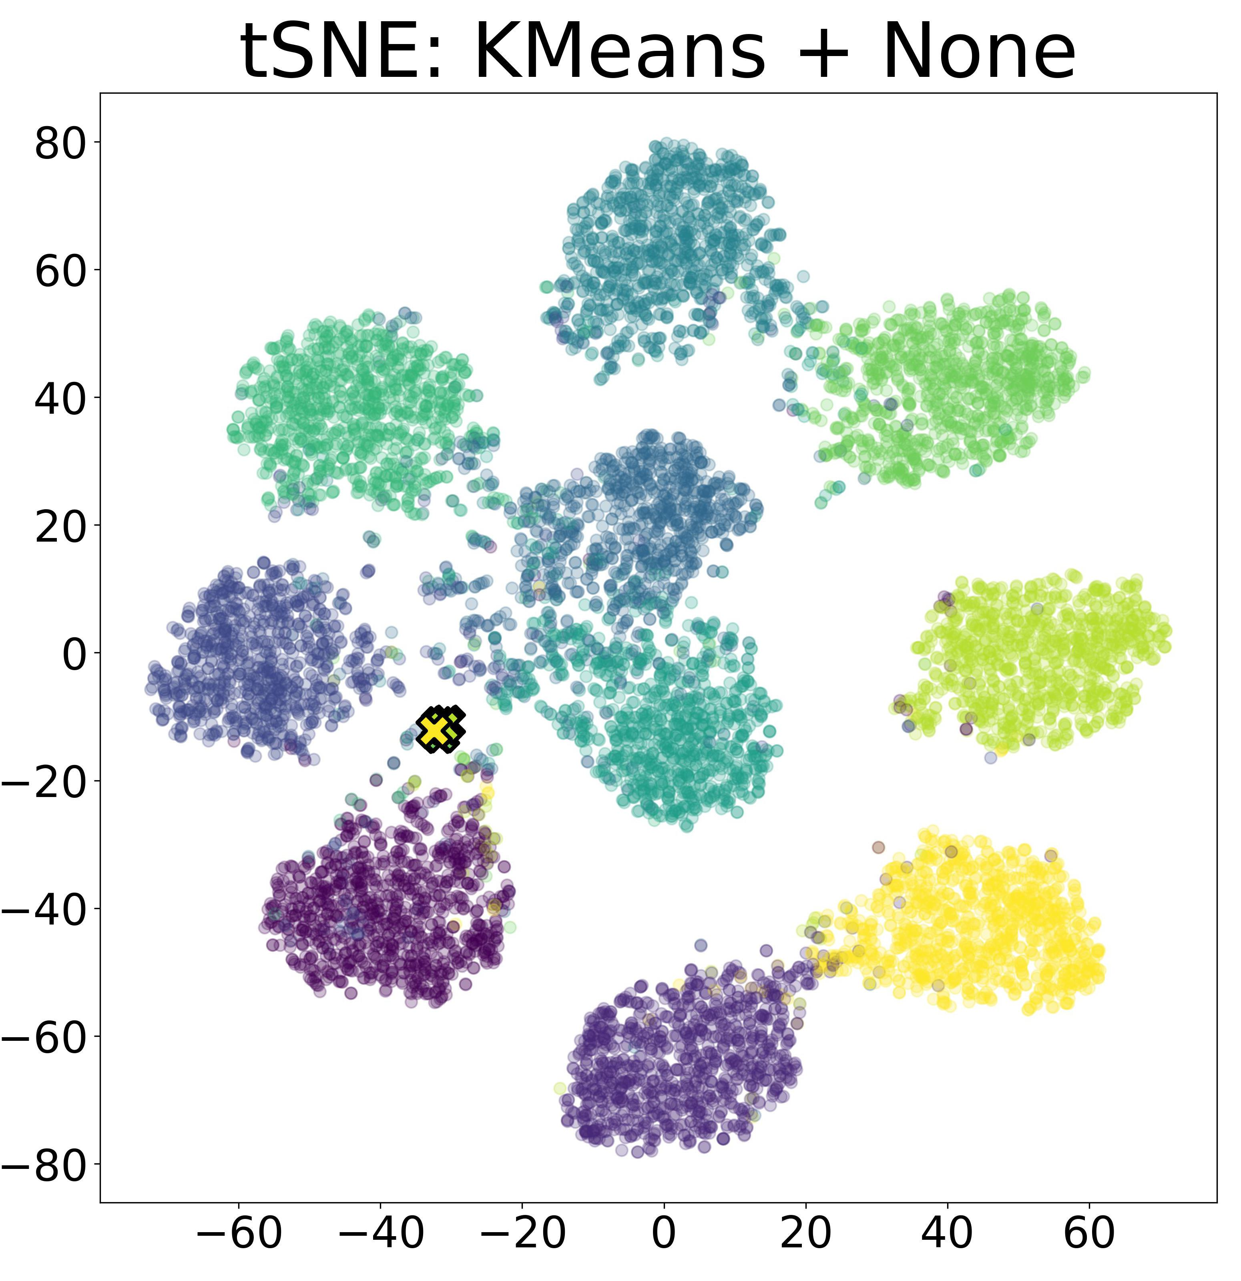
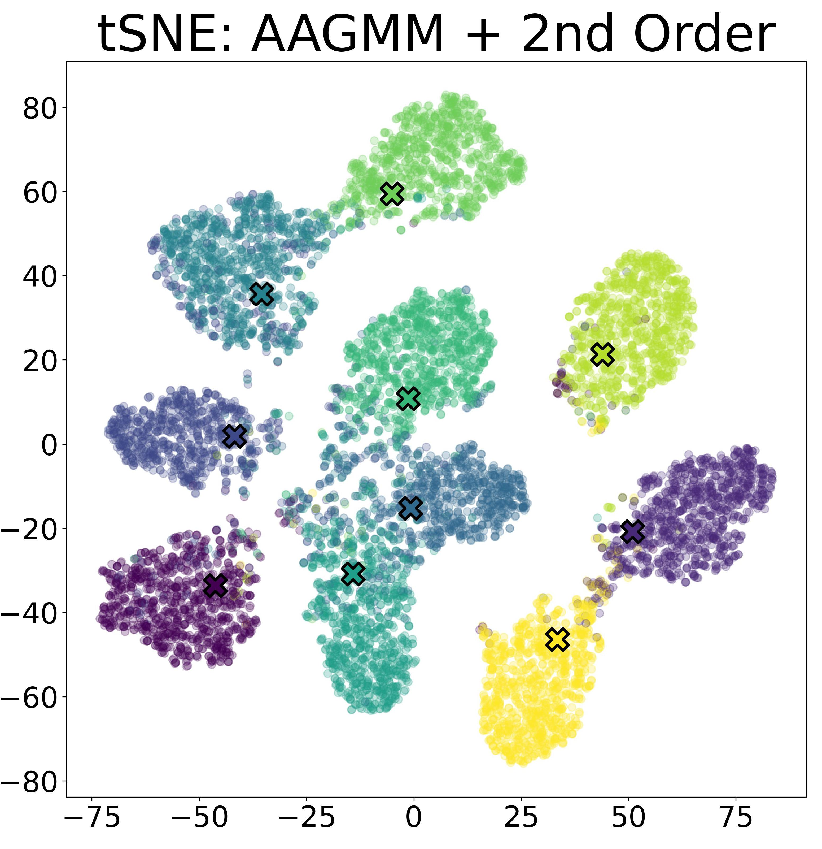
Embedding Visualization

Slide 12
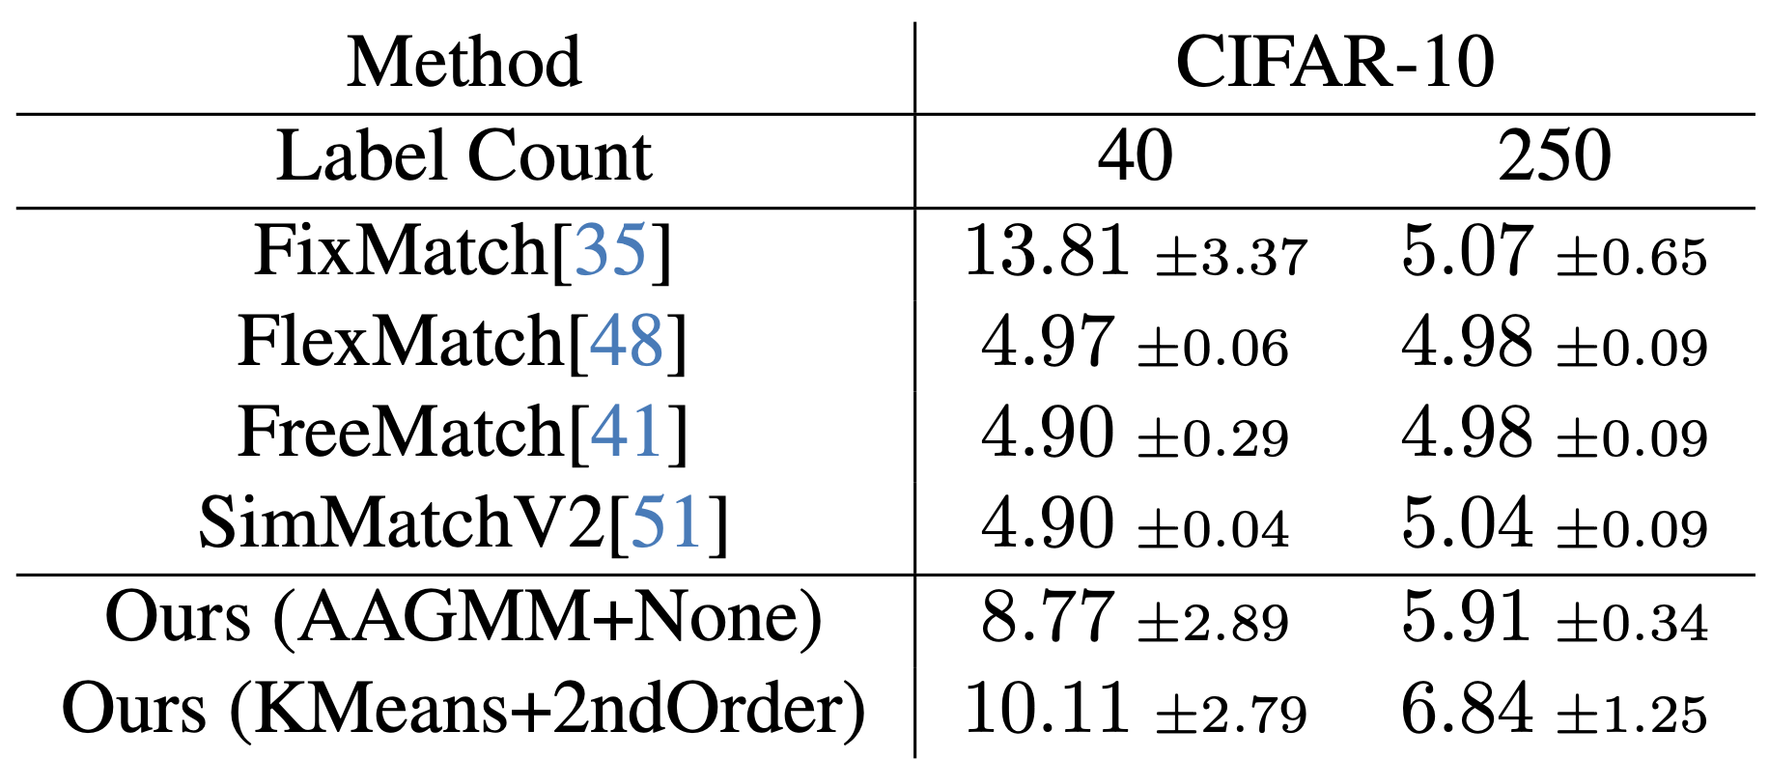
Experiments
All experiments based upon FixMatch
SSL hyper-parameters were not modified
Dataset: CIFAR-10 at 40 and 250 labels.
Compared against SOTA SSL algorithms

Slide 13
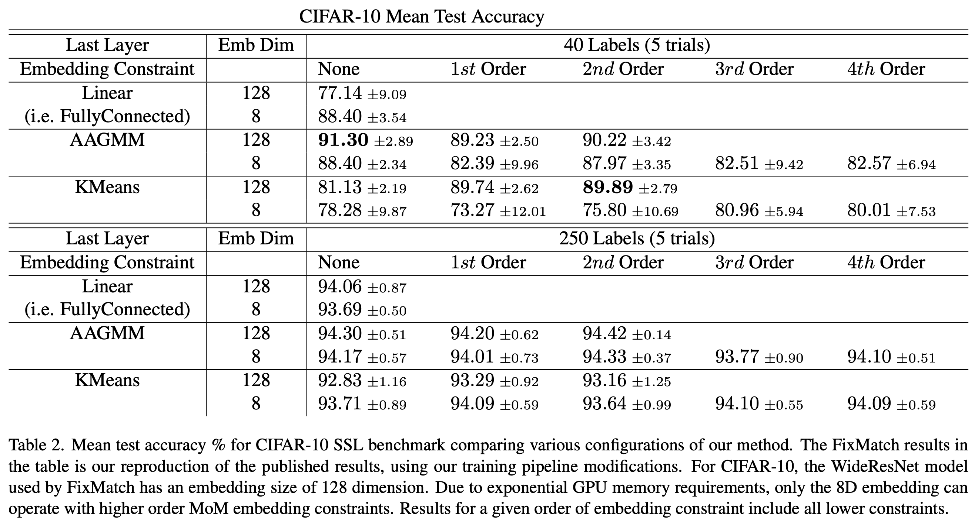

Slide 14
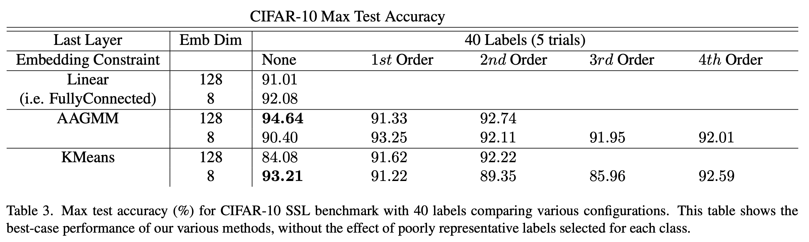
Experiments

Slide 15
TL;DR
Novel linear+softmax replacement which models joint probability distributions
Promising results in embedding space modeling
Needs additional refinement to match SOTA
Shifting to FlexMatch as the baseline
Needs additional experiments to characterize its performance on harder benchmarks
CIFAR-100, STL-10, ImageNet 1k

